Slide 1
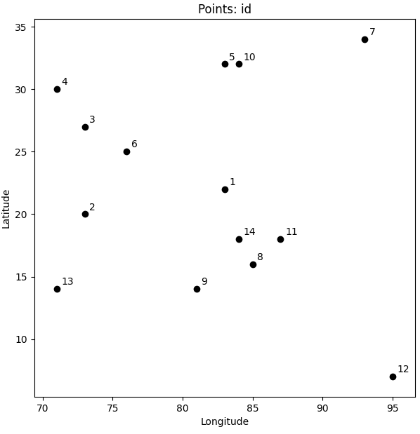
The Travelling Salesman Problem
N-cities exist and a person (salesman) has to travel to all of these cities.
The salesman (traveller) is not allowed to visit any city more than once.

Slide 2
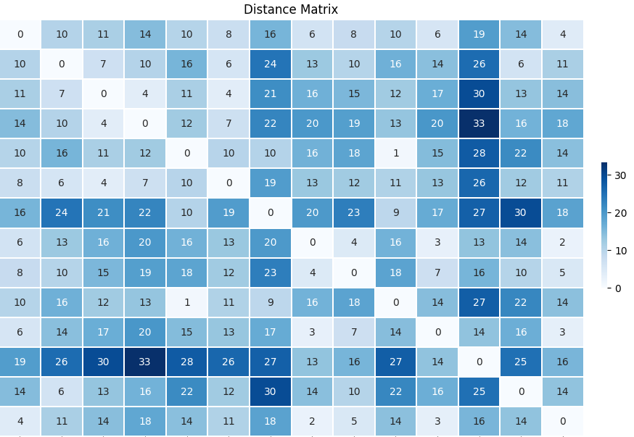
The distance Matrix denoting the distances between any 2 cities is provided
Start Node -> | 1 | 2 | 3 | 4 | 5 | 6 | 7 | 8 | 9 | 10 | 11 | 12 | 13 | 14
1 | 0.0 | 10.2 | 11.2 | 14.4 | 10.0 | 7.6 | 15.6 | 6.3 | 8.2 | 10.0 | 5.7 | 19.2 | 14.4 | 4.1
2 | 10.2 | 0.0 | 7.0 | 10.2 | 15.6 | 5.8 | 24.4 | 12.6 | 10.0 | 16.3 | 14.1 | 25.6 | 6.3 | 11.2
3 | 11.2 | 7.0 | 0.0 | 3.6 | 11.2 | 3.6 | 21.2 | 16.3 | 15.3 | 12.1 | 16.6 | 29.7 | 13.2 | 14.2
4 | 14.4 | 10.2 | 3.6 | 0.0 | 12.2 | 7.1 | 22.4 | 19.8 | 18.9 | 13.2 | 20.0 | 33.2 | 16.0 | 17.7
5 | 10.0 | 15.6 | 11.2 | 12.2 | 0.0 | 9.9 | 10.2 | 16.1 | 18.1 | 1.0 | 14.6 | 27.7 | 21.6 | 14.0
6 | 7.6 | 5.8 | 3.6 | 7.1 | 9.9 | 0.0 | 19.2 | 12.7 | 12.1 | 10.6 | 13.0 | 26.2 | 12.1 | 10.6
7 | 15.6 | 24.4 | 21.2 | 22.4 | 10.2 | 19.2 | 0.0 | 19.7 | 23.3 | 9.2 | 17.1 | 27.1 | 29.7 | 18.4
8 | 6.3 | 12.6 | 16.3 | 19.8 | 16.1 | 12.7 | 19.7 | 0.0 | 4.5 | 16.0 | 2.8 | 13.5 | 14.1 | 2.2
9 | 8.2 | 10.0 | 15.3 | 18.9 | 18.1 | 12.1 | 23.3 | 4.5 | 0.0 | 18.2 | 7.2 | 15.7 | 10.0 | 5.0
10 | 10.0 | 16.3 | 12.1 | 13.2 | 1.0 | 10.6 | 9.2 | 16.0 | 18.2 | 0.0 | 14.3 | 27.3 | 22.2 | 14.0
11 | 5.7 | 14.1 | 16.6 | 20.0 | 14.6 | 13.0 | 17.1 | 2.8 | 7.2 | 14.3 | 0.0 | 13.6 | 16.5 | 3.0
12 | 19.2 | 25.6 | 29.7 | 33.2 | 27.7 | 26.2 | 27.1 | 13.5 | 15.7 | 27.3 | 13.6 | 0.0 | 25.0 | 15.6
13 | 14.4 | 6.3 | 13.2 | 16.0 | 21.6 | 12.1 | 29.7 | 14.1 | 10.0 | 22.2 | 16.5 | 25.0 | 0.0 | 13.6
14 | 4.1 | 11.2 | 14.2 | 17.7 | 14.0 | 10.6 | 18.4 | 2.2 | 5.0 | 14.0 | 3.0 | 15.6 | 13.6 | 0.0

Slide 3
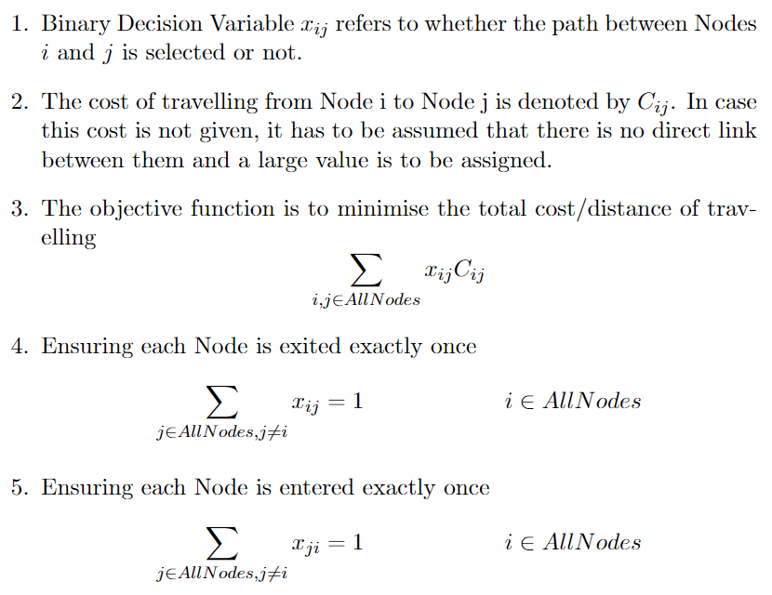
Formulating the Travelling Salesman Problem [TSP]

Slide 4
import pandas as pd
import numpy as np
import matplotlib.pylab as plt
import seaborn as sns
import pulp as p
import random
# Get the Node Locations
location=pd.read_excel("DataFile.xlsx","Nodes",index_col=0)
Y=location.columns.values[0]
X=location.columns.values[1]
n_point=len(location)
# Get the Distance Matrix
data=pd.read_excel("DataFile.xlsx","Distance Matrix",index_col=0)
# Vehicle Depot is assumed to be the first Node from where the Salesman starts the Journey
vehicle_depot=0
# Check TSP state
plt.figure(figsize=(7,7))
# Draw the problem state
for i, row in location.iterrows():
if i == vehicle_depot:
plt.scatter(row[X], row[Y], c='r')
plt.text(row[X] + 0.33, row[Y] + 0.33, 'eV_Depot')
else:
plt.scatter(row[X], row[Y], c='black')
plt.text(row[X] + 0.33, row[Y] + 0.33, f'{i}')
plt.title('Node Points: id')
plt.xlabel(X)
plt.ylabel(Y)
plt.show()
# Set the problem
prob=p.LpProblem("MIP_TSP_Minimize_Small",p.LpMinimize)
# Set Variables
x=p.LpVariable.dicts('x',((i,j) for i in range(n_point) for j in range(n_point)),lowBound=0,upBound=1,cat='Binary')
# Set Objective Function
prob+=p.lpSum(data.iloc[i,j]*x[i,j] for i in range(n_point) for j in range(n_point))
# Set Constraints
for i in range(n_point):
prob+=x[i,i]==0
prob+=p.lpSum(x[i,j] for j in range(n_point))==1
prob+=p.lpSum(x[j,i] for j in range(n_point))==1
# Solve the problem
status=prob.solve()

Slide 5
# Draw the optimal route
plt.figure(figsize=(9,9))
for i, row in location.iterrows():
if i == vehicle_depot:
plt.scatter(row[X], row[Y], c='r')
plt.text(row[X] + 0.33, row[Y] + 0.33, 'Depot')
else:
plt.scatter(row[X], row[Y], c='black')
plt.text(row[X] + 0.33, row[Y] + 0.33,f'{i}')
plt.title('TSP Tour')
plt.xlabel(X)
plt.ylabel(Y)
routes = [(i, j) for i in range(n_point) for j in range(n_point) if p.value(x[i, j]) == 1]
arrowprops = dict(arrowstyle='->', connectionstyle='arc3', edgecolor='blue')
for i, j in routes:
plt.annotate('', xy=[location.iloc[j][X], location.iloc[j][Y]], xytext=[location.iloc[i][X], location.iloc[i][Y]], arrowprops=arrowprops)
plt.show()
#Extracting the Final Path
for v in prob.variables():
z=v.varValue
if z==1:
print(v.name, "=", v.varValue)

Slide 6
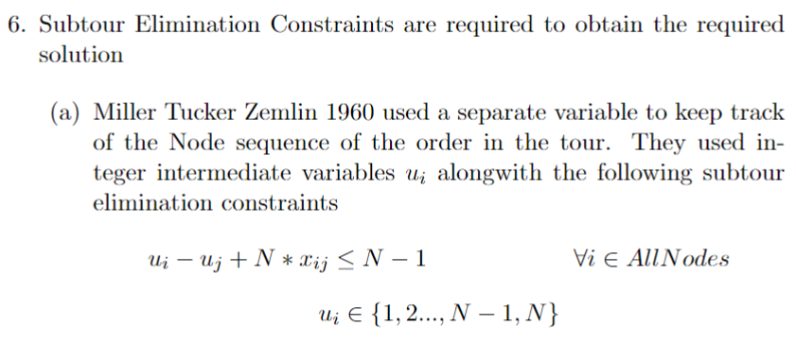
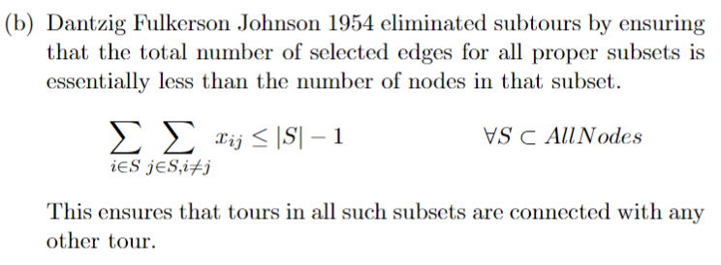
Subtour Elimination Constraints
Miller, Tucker, Zemlin, 1960
Dantzig Fulkerson Johnson 1954

Slide 7
# Subtour Elimination Constraints
# Miller Tucker Zemlin 1960
# Kept track of the order in the tour to eliminate the possibility of subtours
u=p.LpVariable.dicts('u',(i for i in range(n_point)),lowBound=1,upBound=n_point,cat='Integer')
for i in range(n_point):
for j in range(n_point):
if i!=j and i!=vehicle_depot-1 and j!=vehicle_depot-1:
prob+=u[i]-u[j]+n_point*x[i,j]<=n_point-1
# Dantzig, Fulkerson, Johnson, 1954
from itertools import combinations
for h in range(2,n_point):
for S in combinations(range(n_point),h):
prob+=p.lpSum(x[i,j] for i in S for j in S if i!=j)<=h-1
Traveling Salesman Problem - Math 482, Lecture 35 (illinois.edu)

Slide 8
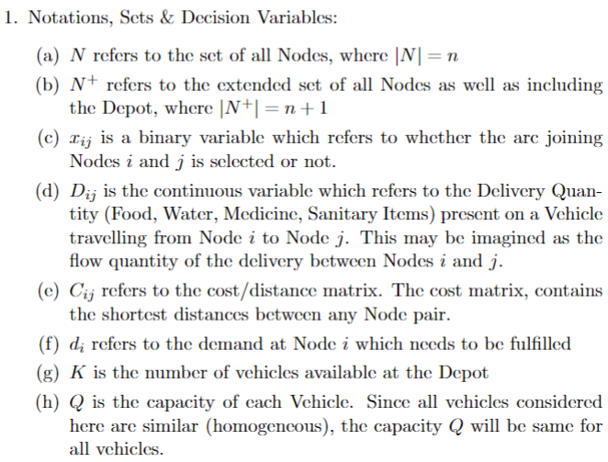
Basic Vehicle Routing Problem
Here we consider a VRP case where vehicles are to deliver certain goods from the Depot to the Demand Points or Nodes.
The capacity of each Vehicle is limited. (Q) The total number of vehicles available at the depot is also limited. (K)
Only a single vehicle is allowed to cater to a single Node. No multi-trip is allowed and any vehicle visits any Node at most once.

Slide 9
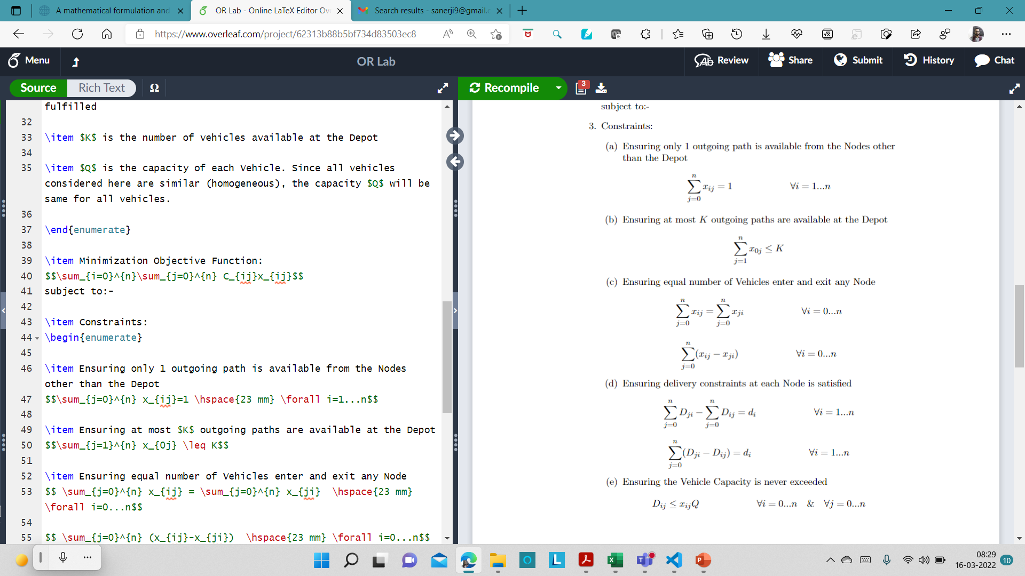
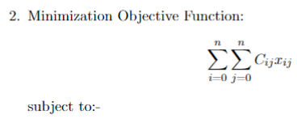

Slide 10
import pandas as pd
import numpy as np
import matplotlib.pylab as plt
import seaborn as sns
import pulp as p
import random
from itertools import combinations
# Depot has both vehicles as well as resources
# Get the Input
Nodes=pd.read_excel("DataFile.xlsx","Nodes & Quantities",index_col=0)
num_of_Nodes=Nodes.shape[0]
num_of_Nodes=int(input("Enter the number of Nodes to consider which must be less than "+str(num_of_Nodes)+" : "))
print()
K=int(input("Enter the number of vehicles available: "))
print()
Q=int(input("Enter the capacity of each vehicle: "))
Distances=pd.read_excel("DataFile.xlsx","Distance Matrix",index_col=0)

Slide 11
plt.figure(figsize=(7,7))
for i, row in Nodes.iterrows():
if i==num_of_Nodes:
break
if i==0:
plt.scatter(row["Longitude"],row["Latitude"], c='r',marker='s')
plt.text( row["Longitude"] + 0.33, row["Latitude"] + 0.33, "Depot")
else:
plt.scatter(row["Longitude"], row["Latitude"], c='black')
plt.text(row["Longitude"] + 0.33, row["Latitude"] + 0.33, i)
plt.title('Depot[RED] -&- Relief Centres[BLACK]')
plt.ylabel("Latitude")
plt.xlabel("Longitude")
plt.show()

Slide 12
# Set the problem
prob=p.LpProblem("VRP_Homogeneous_Vehicles_Single_Depot",p.LpMinimize)
# Decision Variables
# Iff Arc joining i & j is included within the solution
x=p.LpVariable.dicts('x',((i,j) for i in range(num_of_Nodes) for j in range(num_of_Nodes)),cat='Binary')
# Amount of delivery load across Arc(i,j)
D=p.LpVariable.dicts('D',((i,j) for i in range(num_of_Nodes) for j in range(num_of_Nodes)),lowBound=0)
# Set Objective Function
prob+=p.lpSum(Distances.iloc[i,j]*x[i,j] for i in range(num_of_Nodes) for j in range(num_of_Nodes))

Slide 13
# Set Constraints
# Ensuring only 1 outgoing path is available from the Nodes other than the Depot
for i in range(1,num_of_Nodes):
prob+=p.lpSum(x[i,j] for j in range(num_of_Nodes))==1
# Ensuring at most K outgoing paths are available at the Depot
prob+=p.lpSum(x[0,j] for j in range(1,num_of_Nodes))<=K
# Ensuring equal number of Incoming and Outgoing paths are available from all Nodes
for i in range(num_of_Nodes):
prob+=p.lpSum(x[i,j] for j in range(num_of_Nodes))==p.lpSum(x[j,i] for j in range(num_of_Nodes))
# Delivery Constraints
for i in range(1,num_of_Nodes):
prob+=p.lpSum(D[j,i]-D[i,j] for j in range(num_of_Nodes))==Nodes.iloc[i,2]
# Ensuring the vehicle capacity is never exceeded
for i in range(num_of_Nodes):
for j in range(num_of_Nodes):
prob+=D[i,j]<=Q*x[i,j]

Slide 14
# Solve the problem
status=prob.solve()
plt.figure(figsize=(9,9))
for i, row in Nodes.iterrows():
if i==num_of_Nodes:
break
if i==0:
plt.scatter(row["Longitude"],row["Latitude"], c='r',marker='s')
plt.text( row["Longitude"] + 0.33, row["Latitude"] + 0.33, "Depot")
else:
plt.scatter(row["Longitude"], row["Latitude"], c='black')
plt.text(row["Longitude"] + 0.33, row["Latitude"] + 0.33, i)
plt.title('mVRPSDC Tours')
plt.ylabel("Latitude")
plt.xlabel("Longitude")

Slide 15
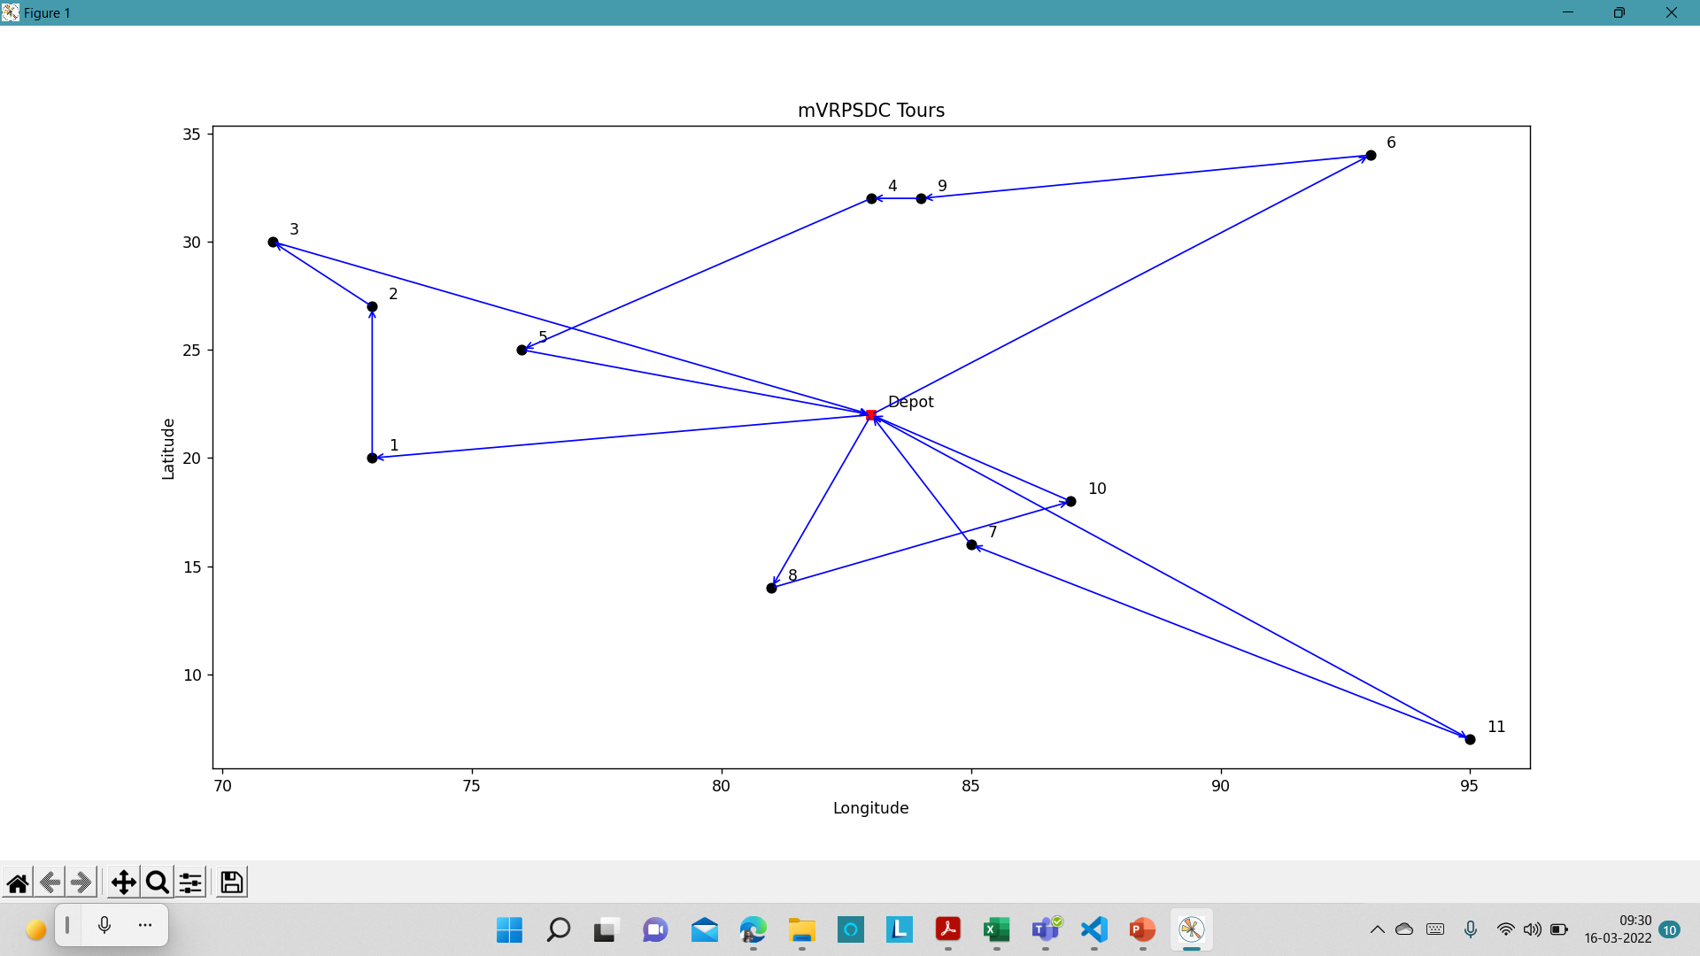
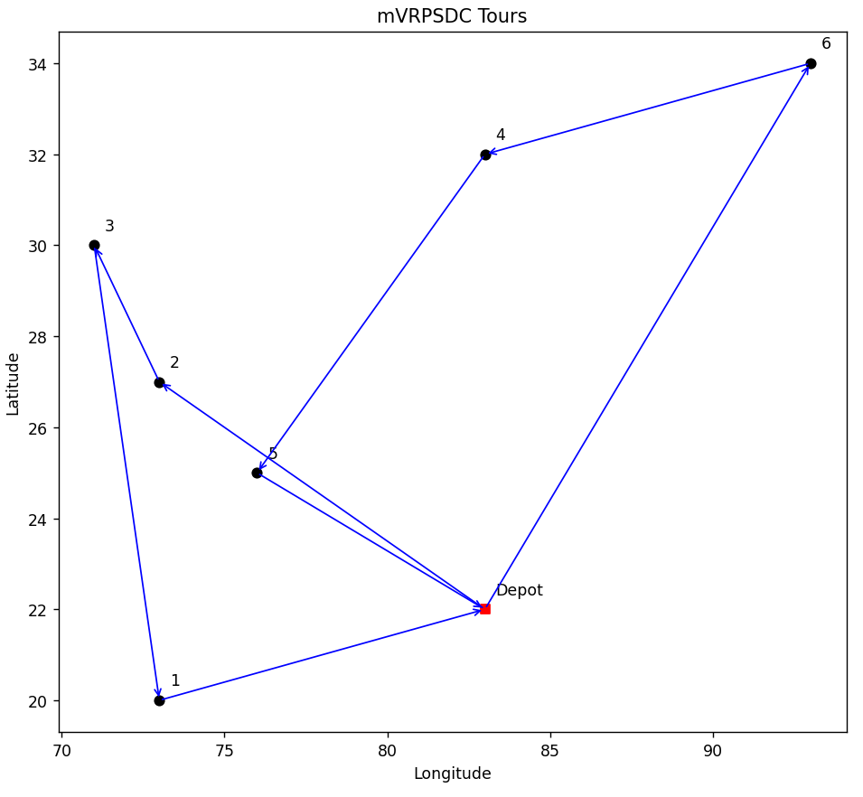
routes = [(i, j) for i in range(num_of_Nodes) for j in range(num_of_Nodes) if p.value(x[i,j])==1]
arrowprops = dict(arrowstyle='->', connectionstyle='arc3', edgecolor='blue’)
for i, j in routes:
plt.annotate('', xy=[Nodes.iloc[j]["Longitude"], Nodes.iloc[j]["Latitude"]], xytext=[Nodes.iloc[i]["Longitude"], Nodes.iloc[i]["Latitude"]], arrowprops=arrowprops)
plt.show()

